Slide 1

TerriaJS - An open-source framework for
web-based geospatial catalogue explorers
NATIONAL MAP
“TerriaJS was born late 2014 thanks to NationalMap. It started as a web based platform prototype to test how to easily visualise the spatial data on https://data.gov.au/. Its core approach is data federation and slick user interface, all in a web browser. No plugins, no downloads. The platform grew from a handful of datasets from the then Department of Communications, to over 10,000 datasets today from over 50 organisations, ranging from Australian Commonwealth agencies, State and Local governments, cities and universities. The Australian NationalMap platform contributed greatly in opening data by government agencies and in discovering and consuming open data by general public, industry, academia and the government itself. NationalMap is managed and maintained by: Digital Transformation Agency - product ownership, Geoscience Australia - product hosting, Data61 Terria - product software development.”^{[Ref]}
This presentation is to demonstrate its use with GSKY
It is primarily for developers, but is also a user guide.
Will take approximately 5 minutes to watch this animation.
Open the *.pptx for controlled slideshow at your pace.
The slide show will begin in 5 seconds !

Slide 2
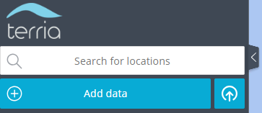
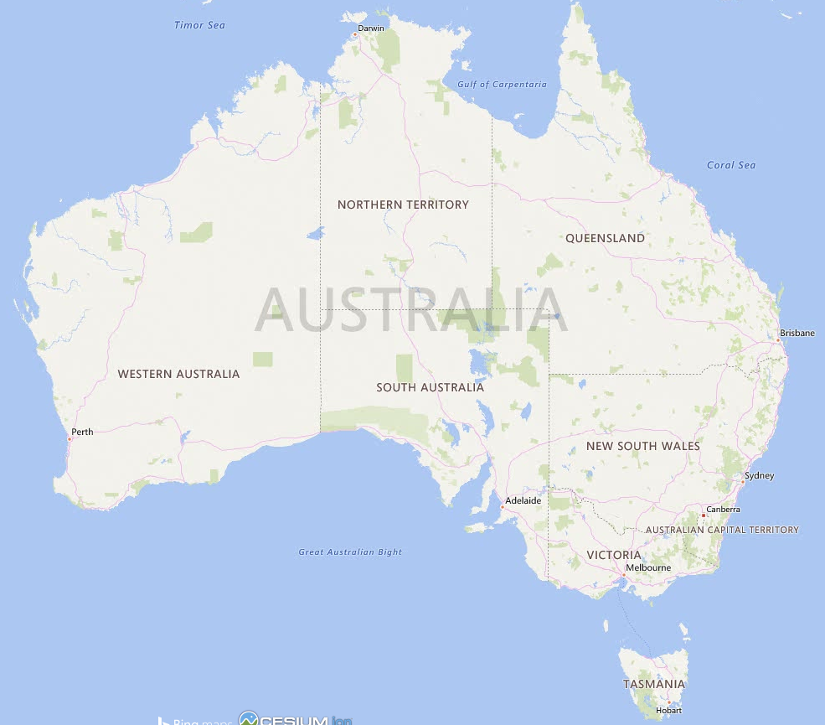



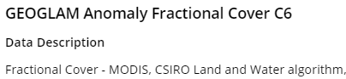
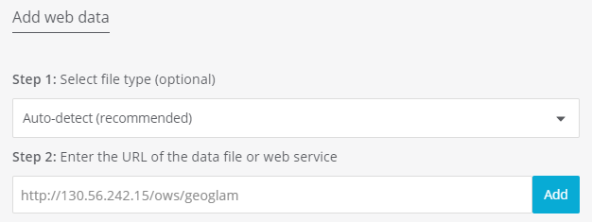
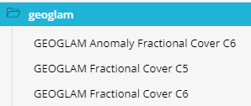

GEOGLAM – An implementation via GSKY in TerriaJS
http://130.56.242.15/ows/geoglam?service=WMS&version=1.1.1&sld_version=1.1.0&request=DescribeLayer&layers=global%3Ac6%3Amonthly_anom_frac_cover DescribeLayer:
utils.ExecuteWriteTemplateFile(w, conf.Layers[idx], utils.DataDir+"/templates/WMS_DescribeLayer.tpl")
Geo-spatial data stored in GSKY database can be layered over a world map. Steps and code snippets to show the usage and inner workings.
http://130.56.242.15/ows/geoglam?service=WMS&request=GetCapabilities&version=1.3.0&tiled=true
GetCapabilities:
utils.ExecuteWriteTemplateFile(w, conf, utils.DataDir+"/templates/WMS_GetCapabilities.tpl")
Next Slide

Slide 3

GEOGLAM – An implementation via GSKY in TerriaJS

